Slide 1


MINIPROJECT
1

Slide 2
Index
2
Sr no | index
1 | Undesrstanding Concepts
2 | Different Parts
3 | Assembly
5 | Techdraws
6 | Insights
Sr. no
1
2
3
4
5
Contents
Week1Sketch1
Week1Sketch2 Week1Assignment1
Week1Assignment2 Insights

Slide 3
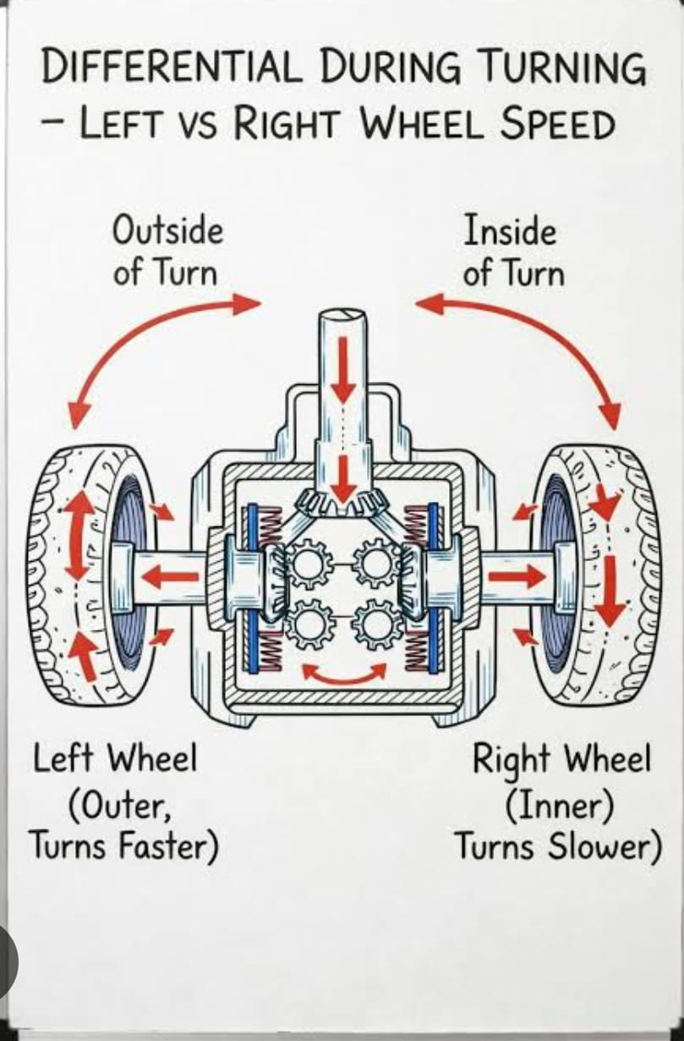
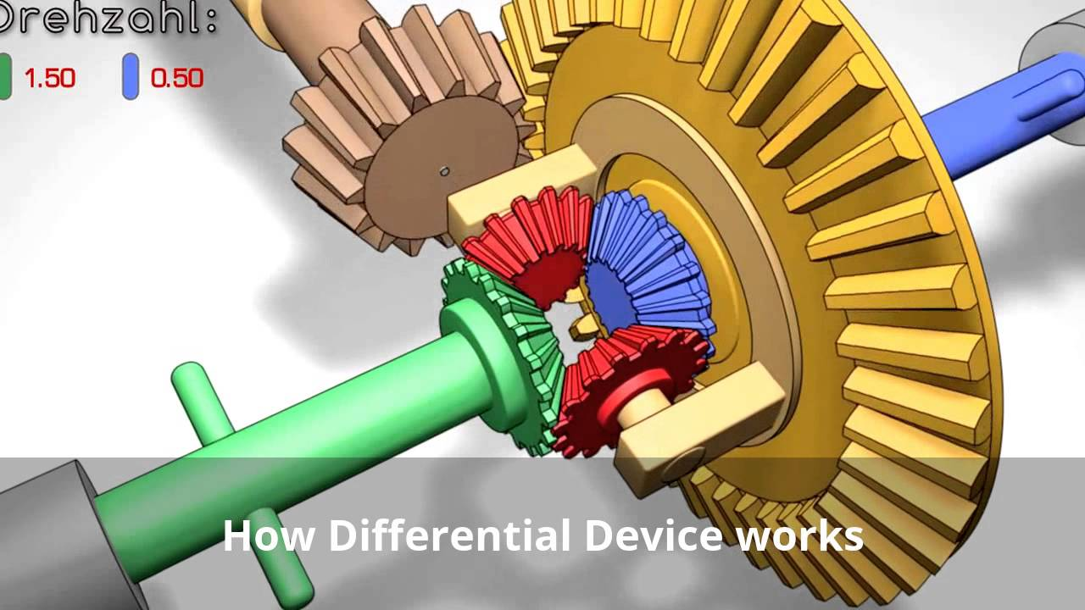
Diffrential gear

Slide 4
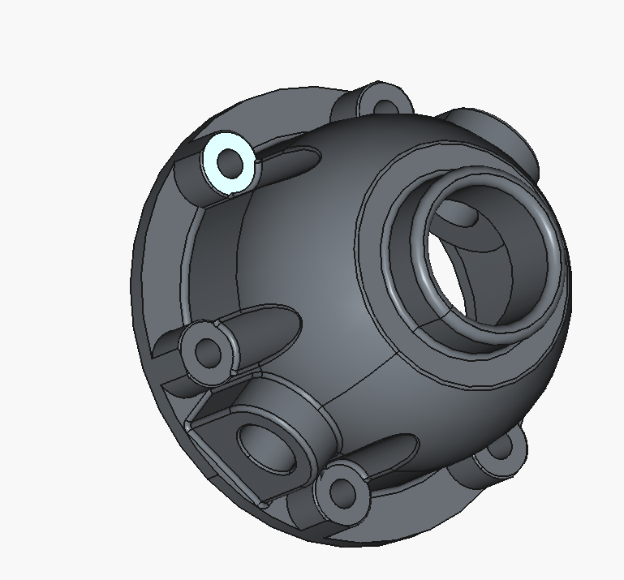
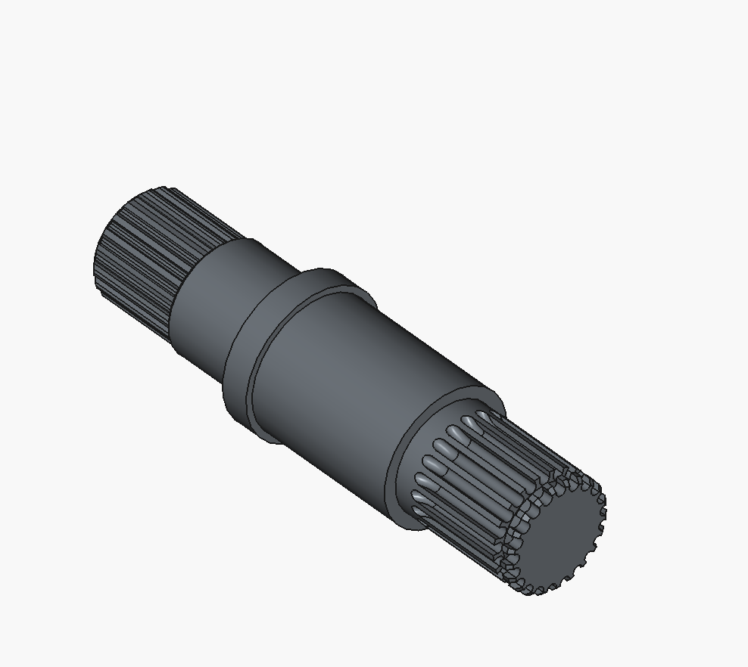
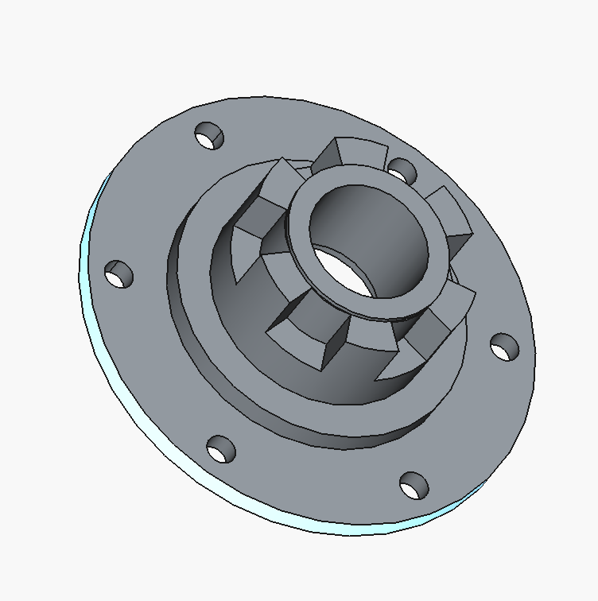
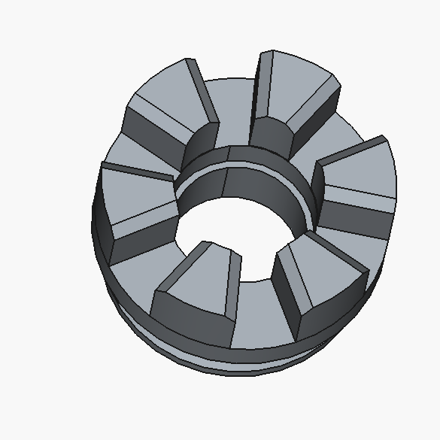
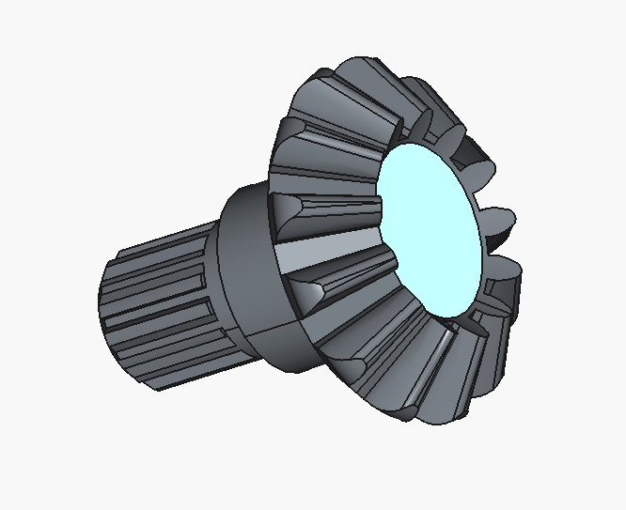
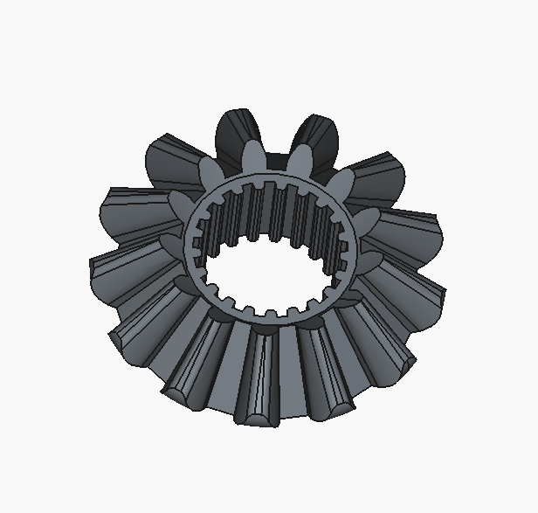
Parts

Slide 5
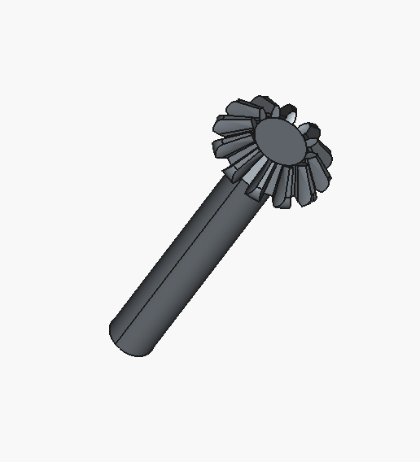
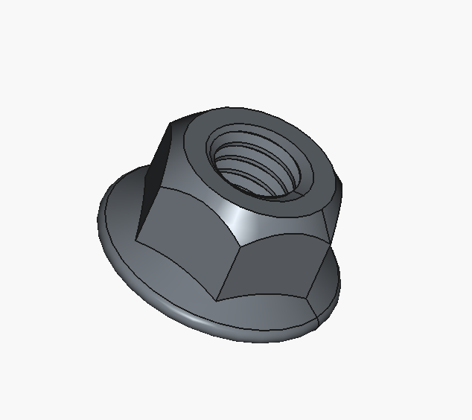
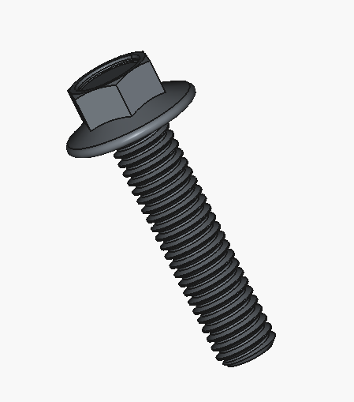
Parts

Slide 6
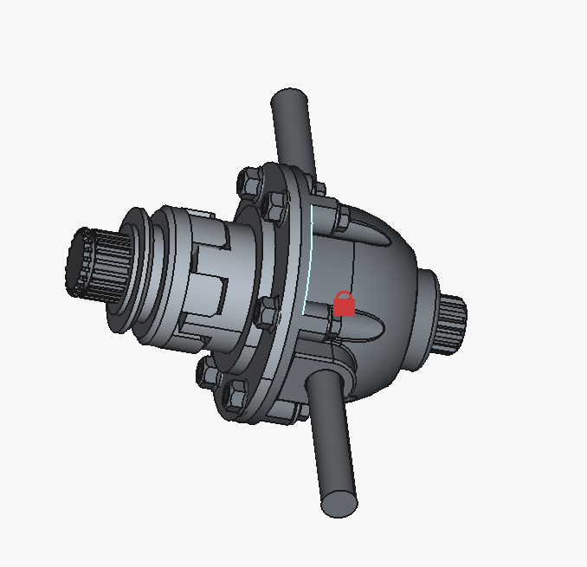
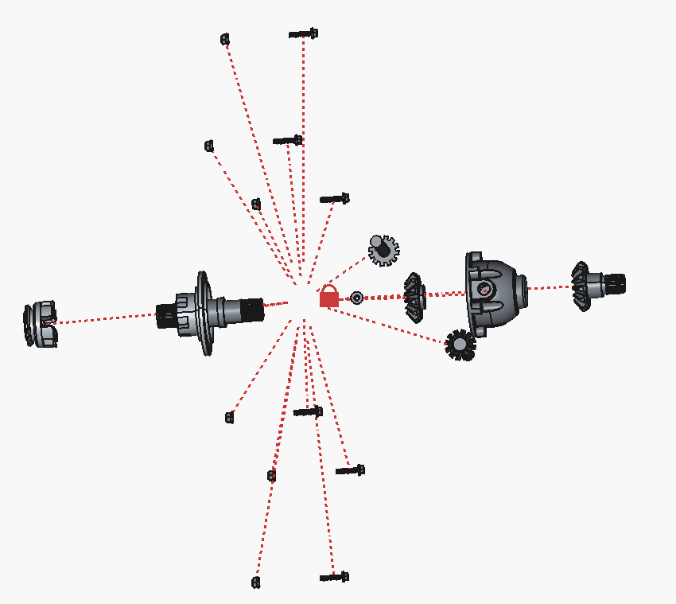
Assembly
Complete Differential
Exploded VIew

Slide 7
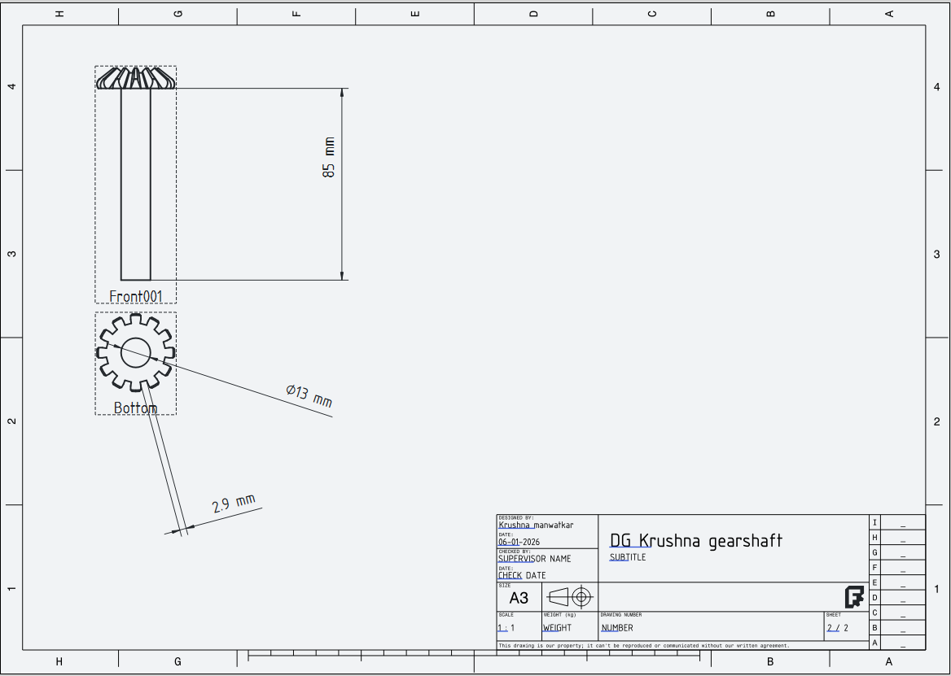
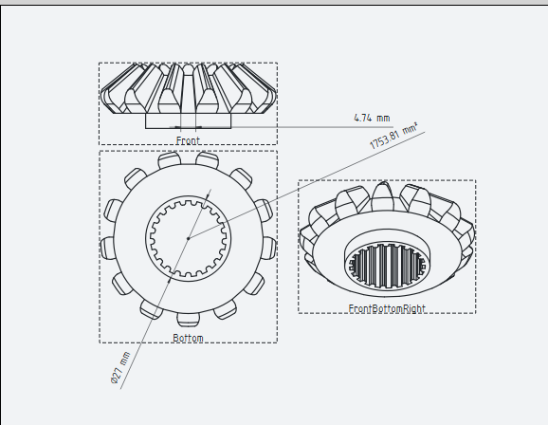
Techdraws

Slide 8
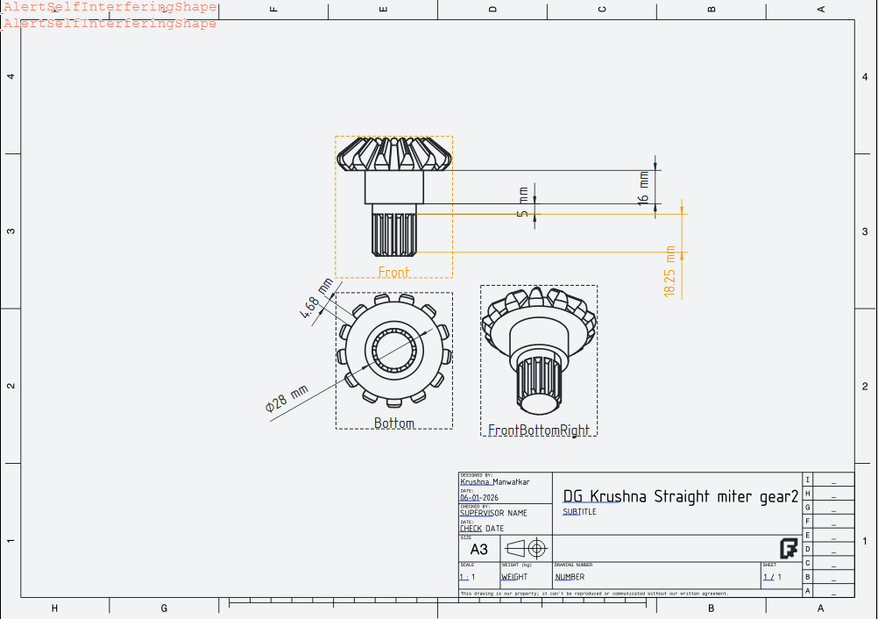
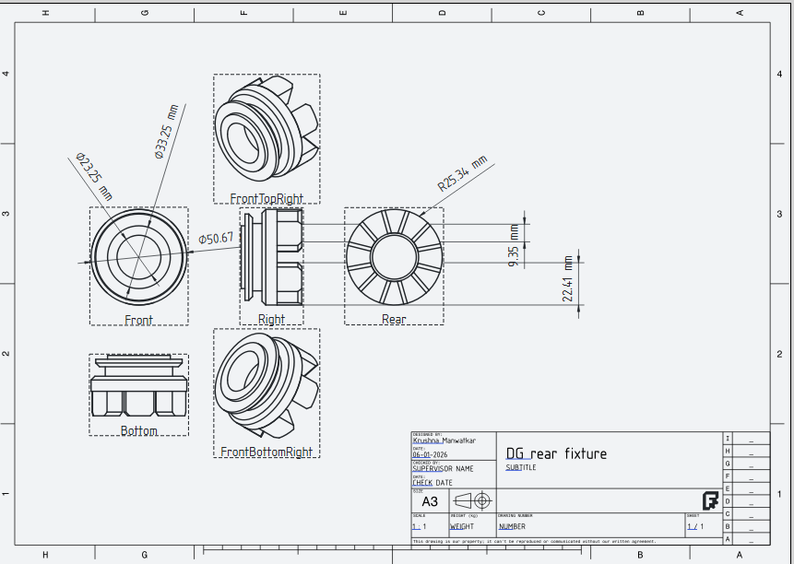
Techdraws

Slide 9
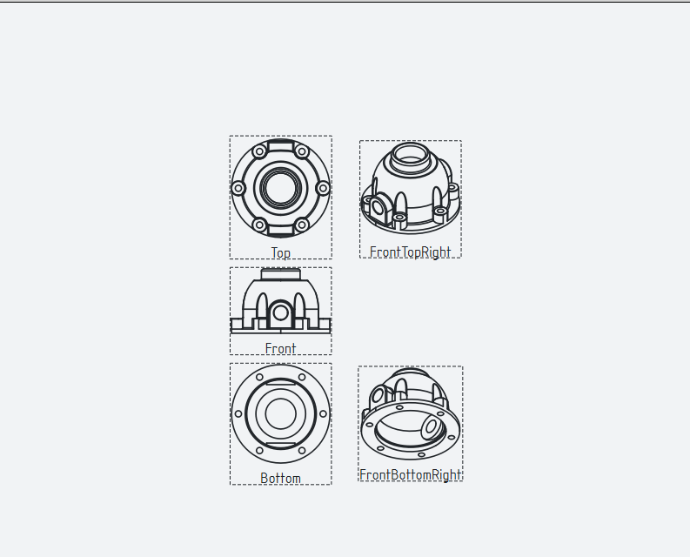
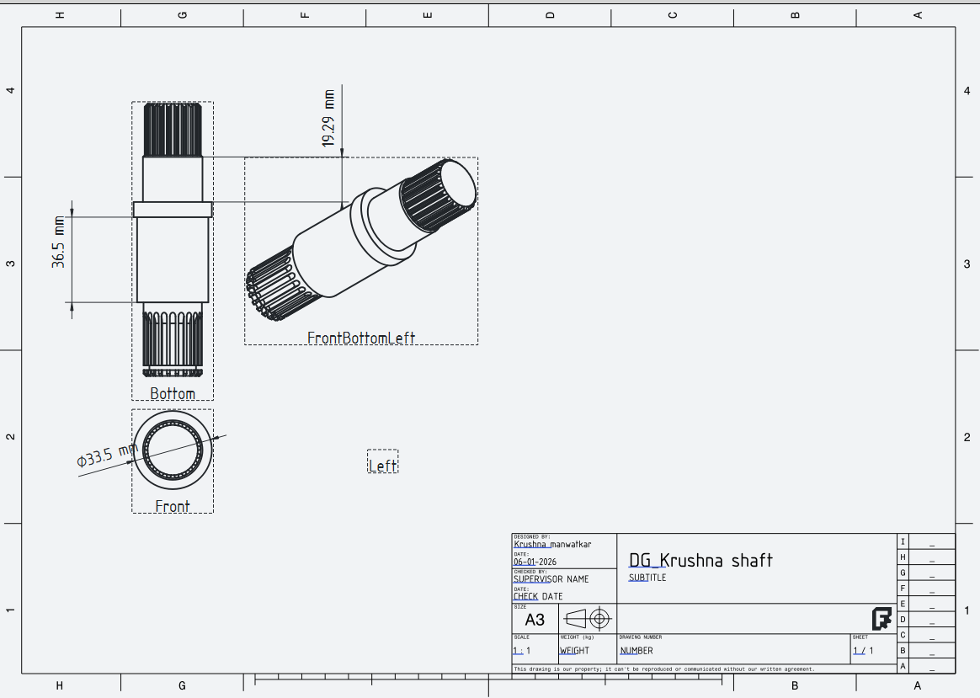
Techdraws

Slide 10
Insights
1.Neatness
2.Oragnization
3.Reading Drawings
4.Engineering Apporach
5.Gear worksbench

